Slide 1
COMP 1017 01 – Introduction to Web
James Grieve

Slide 2
What is a Website? Part 1
A collection of pages stored on a server (professional grade computer) which are served at request to clients.
“Webservers” are servers configured for this purpose.
Composed of files and scripts of many types, including images, videos and code files.
Code files are most commonly of HTML, CSS and JS types, but can also be of other types if the server supports them.

Slide 3
What is a Website? Part 2
Basic websites do not need to be stored on a server to be viewed by you as a developer.
This is called a local copy of the website.
Local copies can be opened by putting the path to the website folder in place of the URL in your web browser, or by simply opening an HTML file in the folder.
By the nature of being local, only the computer that has the files on it can view the website, unless it is shared by other means.
Some websites need to be deployed to servers to see changes, or have server software installed on your computer.
An example of this are PHP, which can be installed on your computer but is typically executed on servers before the website pages are served to clients.

Slide 4

What is HTML?
Stands for Hyper Text Markup Language.
Not a language that executes commands or instructions directly, rather provides structure to content.
Consists primarily of tags which enclose content and are interpreted by browsers to determine basic layout and structure.
HTML5 is the latest version which comes with some new best practices.

Slide 5

What is CSS?
Stands for Cascading Style Sheets.
Not a language that executes commands or instructions directly either, rather provides style to content.
Consists primarily of selectors and attributes which are interpreted by browsers to change how HTML looks.
CSS3 is the latest version of CSS that has been implemented in browsers, and supports many new features over previous versions.

Slide 6

What is JS?
Stands for JavaScript.
A more traditional programming language designed to allow web pages to be more interactive.
Similar to Java in syntax but is not directly related.
Not owned or maintained by a single organization, rather features are developed by many individuals and implemented in browsers.
We won’t be covering JavaScript extensively in this course.

Slide 7
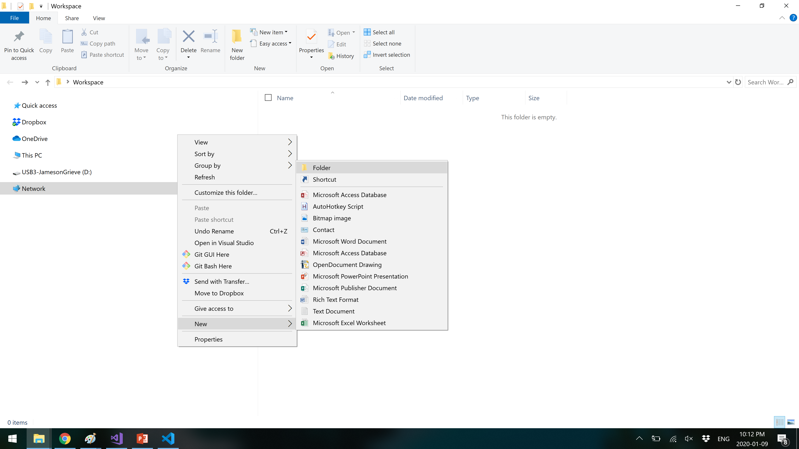
Creating A New Basic Website Part 1
Start by creating a new folder.
On Windows, this is done by right clicking in a directory, and clicking “New”, and then “Folder”.
Alternatively, you can Control, and Shift, and press the N key. (Ctrl+Shift+N)

Slide 8
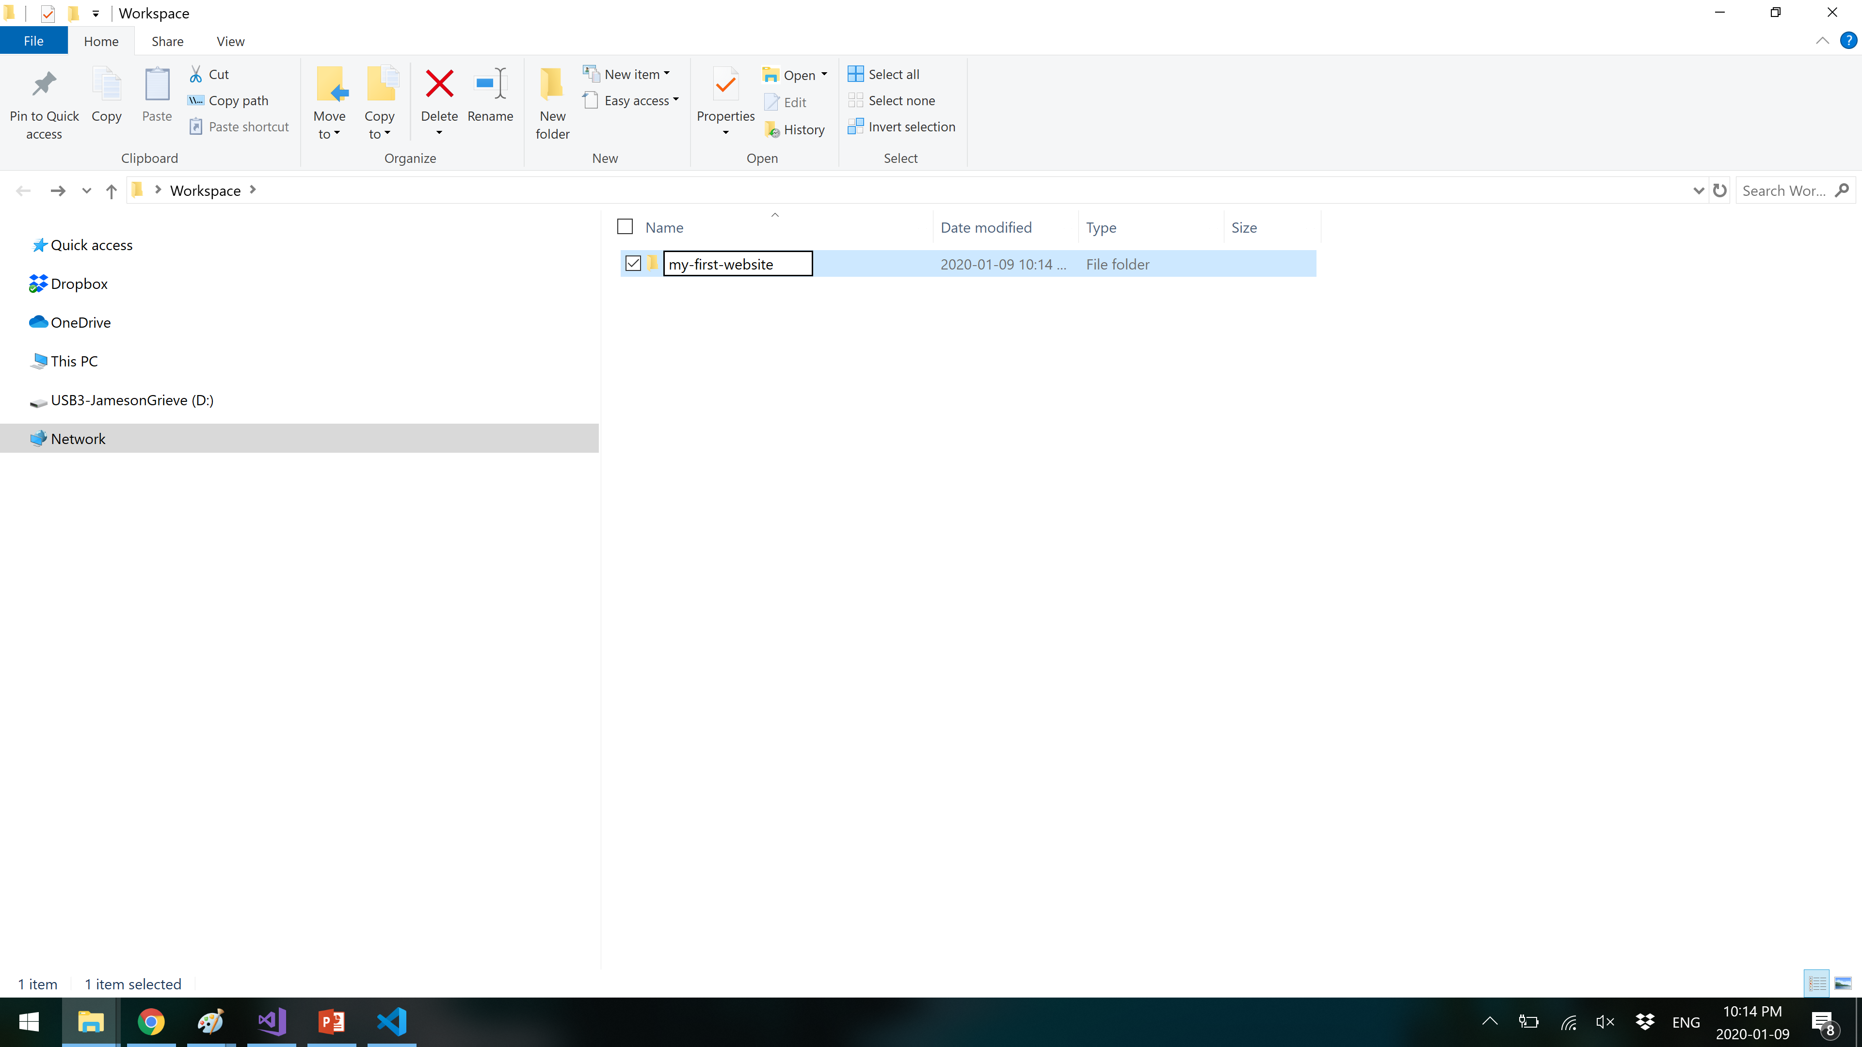
Creating A New Basic Website Part 2
Name your new website folder.
Best practices suggest to use “Kebab Case” for naming directories and files in web.
Kebab case means each word is separated by a dash / hyphen, and all characters are lowercase.
here-is-an-example-of-kebab-case
This has two purposes, it stops messy URLs, and functions better on Linux based webservers.

Slide 9
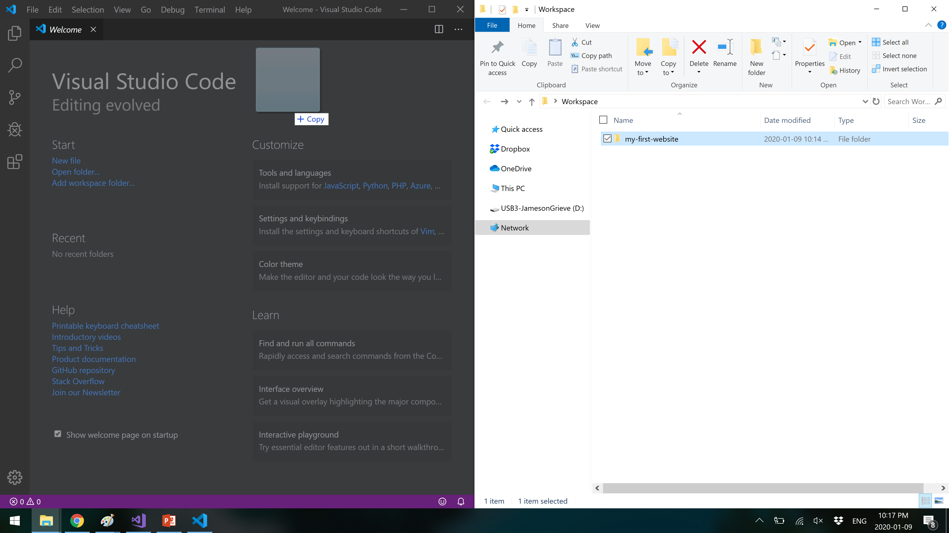
Creating A New Basic Website Part 3
Once your website “root” folder is created, click and drag it into Visual Studio Code (hereon to be referred to as VS Code).
Most other IDEs will have a similar functionality, but I will be demonstrating VS Code. If you are familiar with another IDE, feel free to use it.

Slide 10
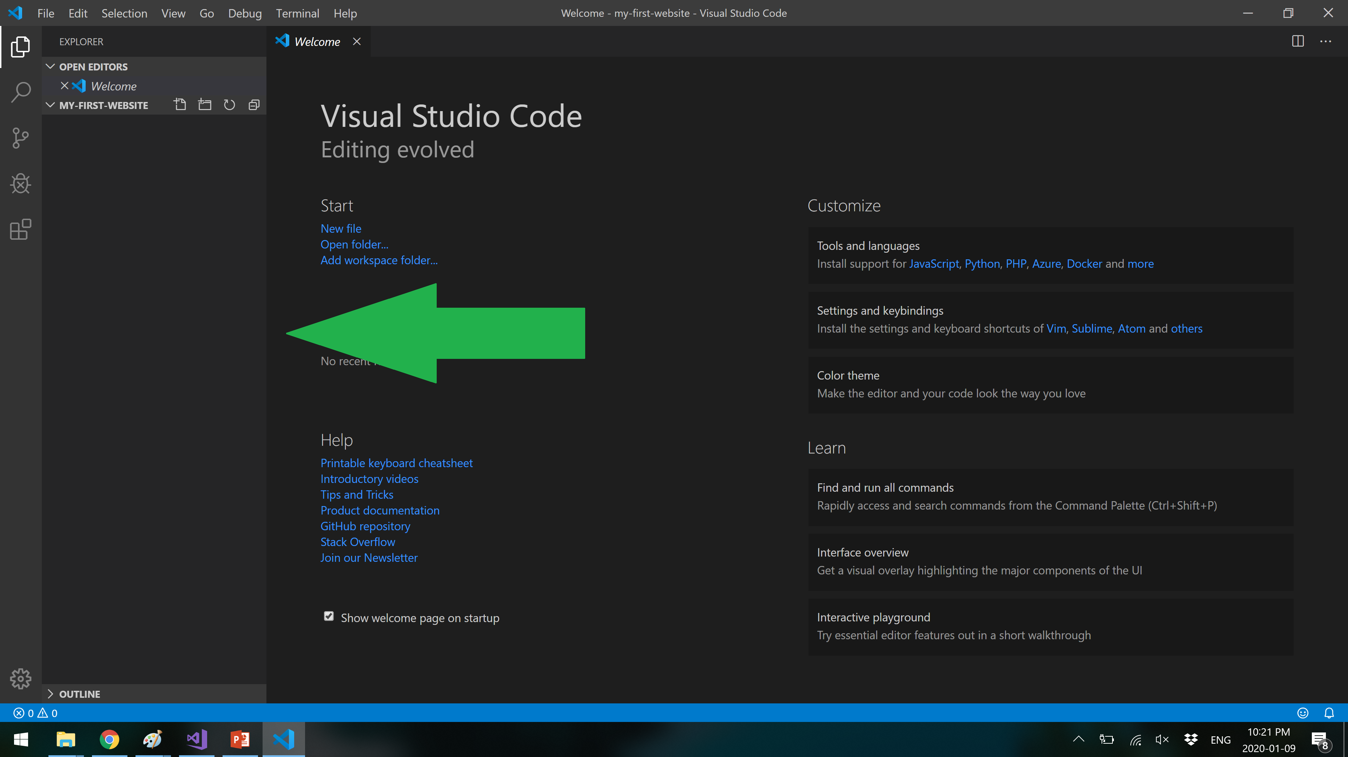
Creating A New Basic Website Part 4
Dragging the folder into VS Code will open a “Workspace” for your website. This is an easy way to work on multiple files without bouncing back and forth between VS Code and Windows explorer.

Slide 11
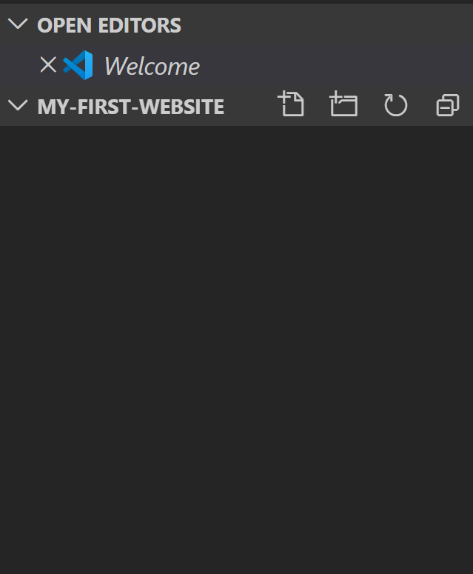
Creating A New Basic Website Part 5
From left to right, the workspace buttons are: “New File”, “New Folder”, “Refresh” and “Collapse”.
“New File” will create a new file in the selected directory (or in the root if there is nothing selected).
“New Folder” will behave similarly to “New File” but will create a directory instead.
“Refresh” will refresh the directory if it has been changed from outside of VS Code (such as windows explorer, an FTP client, etc).
“Collapse” will collapse the view to allow you to navigate more easily.

Slide 12
Before We Continue
Does Everyone Understand File Extensions?

Slide 13
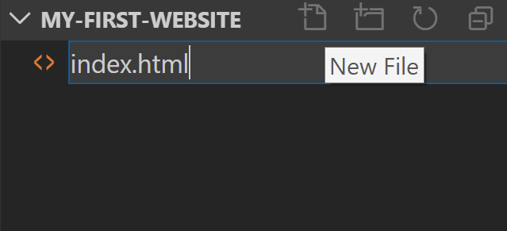
Creating A New Basic Website Part 6
Let’s start by creating a basic HTML file.
Click “New File”, and create a file called “index.html”.
You’ll notice that as you type the file extension, the icon to the left of the file name will update to reflect the current extension.
The name “index” is not insignificant. It is the default file that will be served by the webserver if no file is given in the URL.

Slide 14
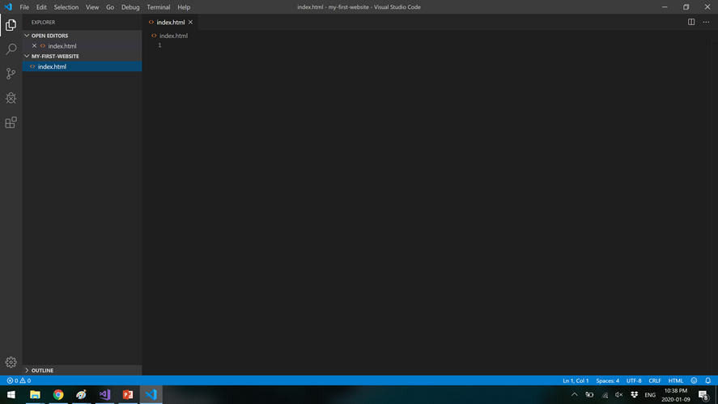
Creating A New Basic Website Part 7
If you click on the file you just created, it will open it in the editor window.
As you can see, it is blank right now. Let’s add some text.

Slide 15
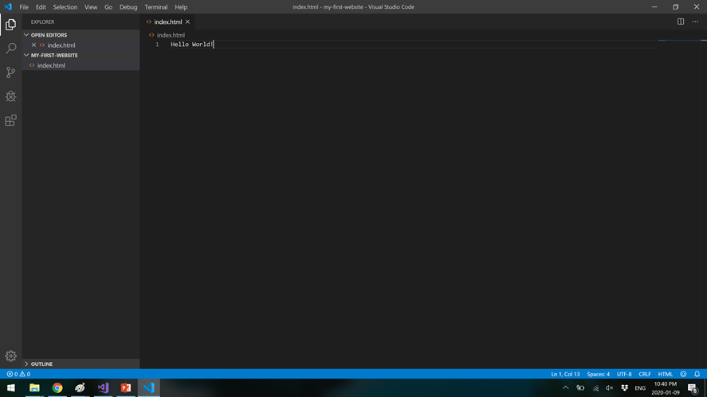
Creating A New Basic Website Part 8
Go ahead any type some text in the editor.
Once you’re done, hit “File”, then “Save”, or hit Ctrl+S.
The circle in the tab at the top should change to an X when the file is saved. If any of your files have that circle, you know they have not been saved.

Slide 16
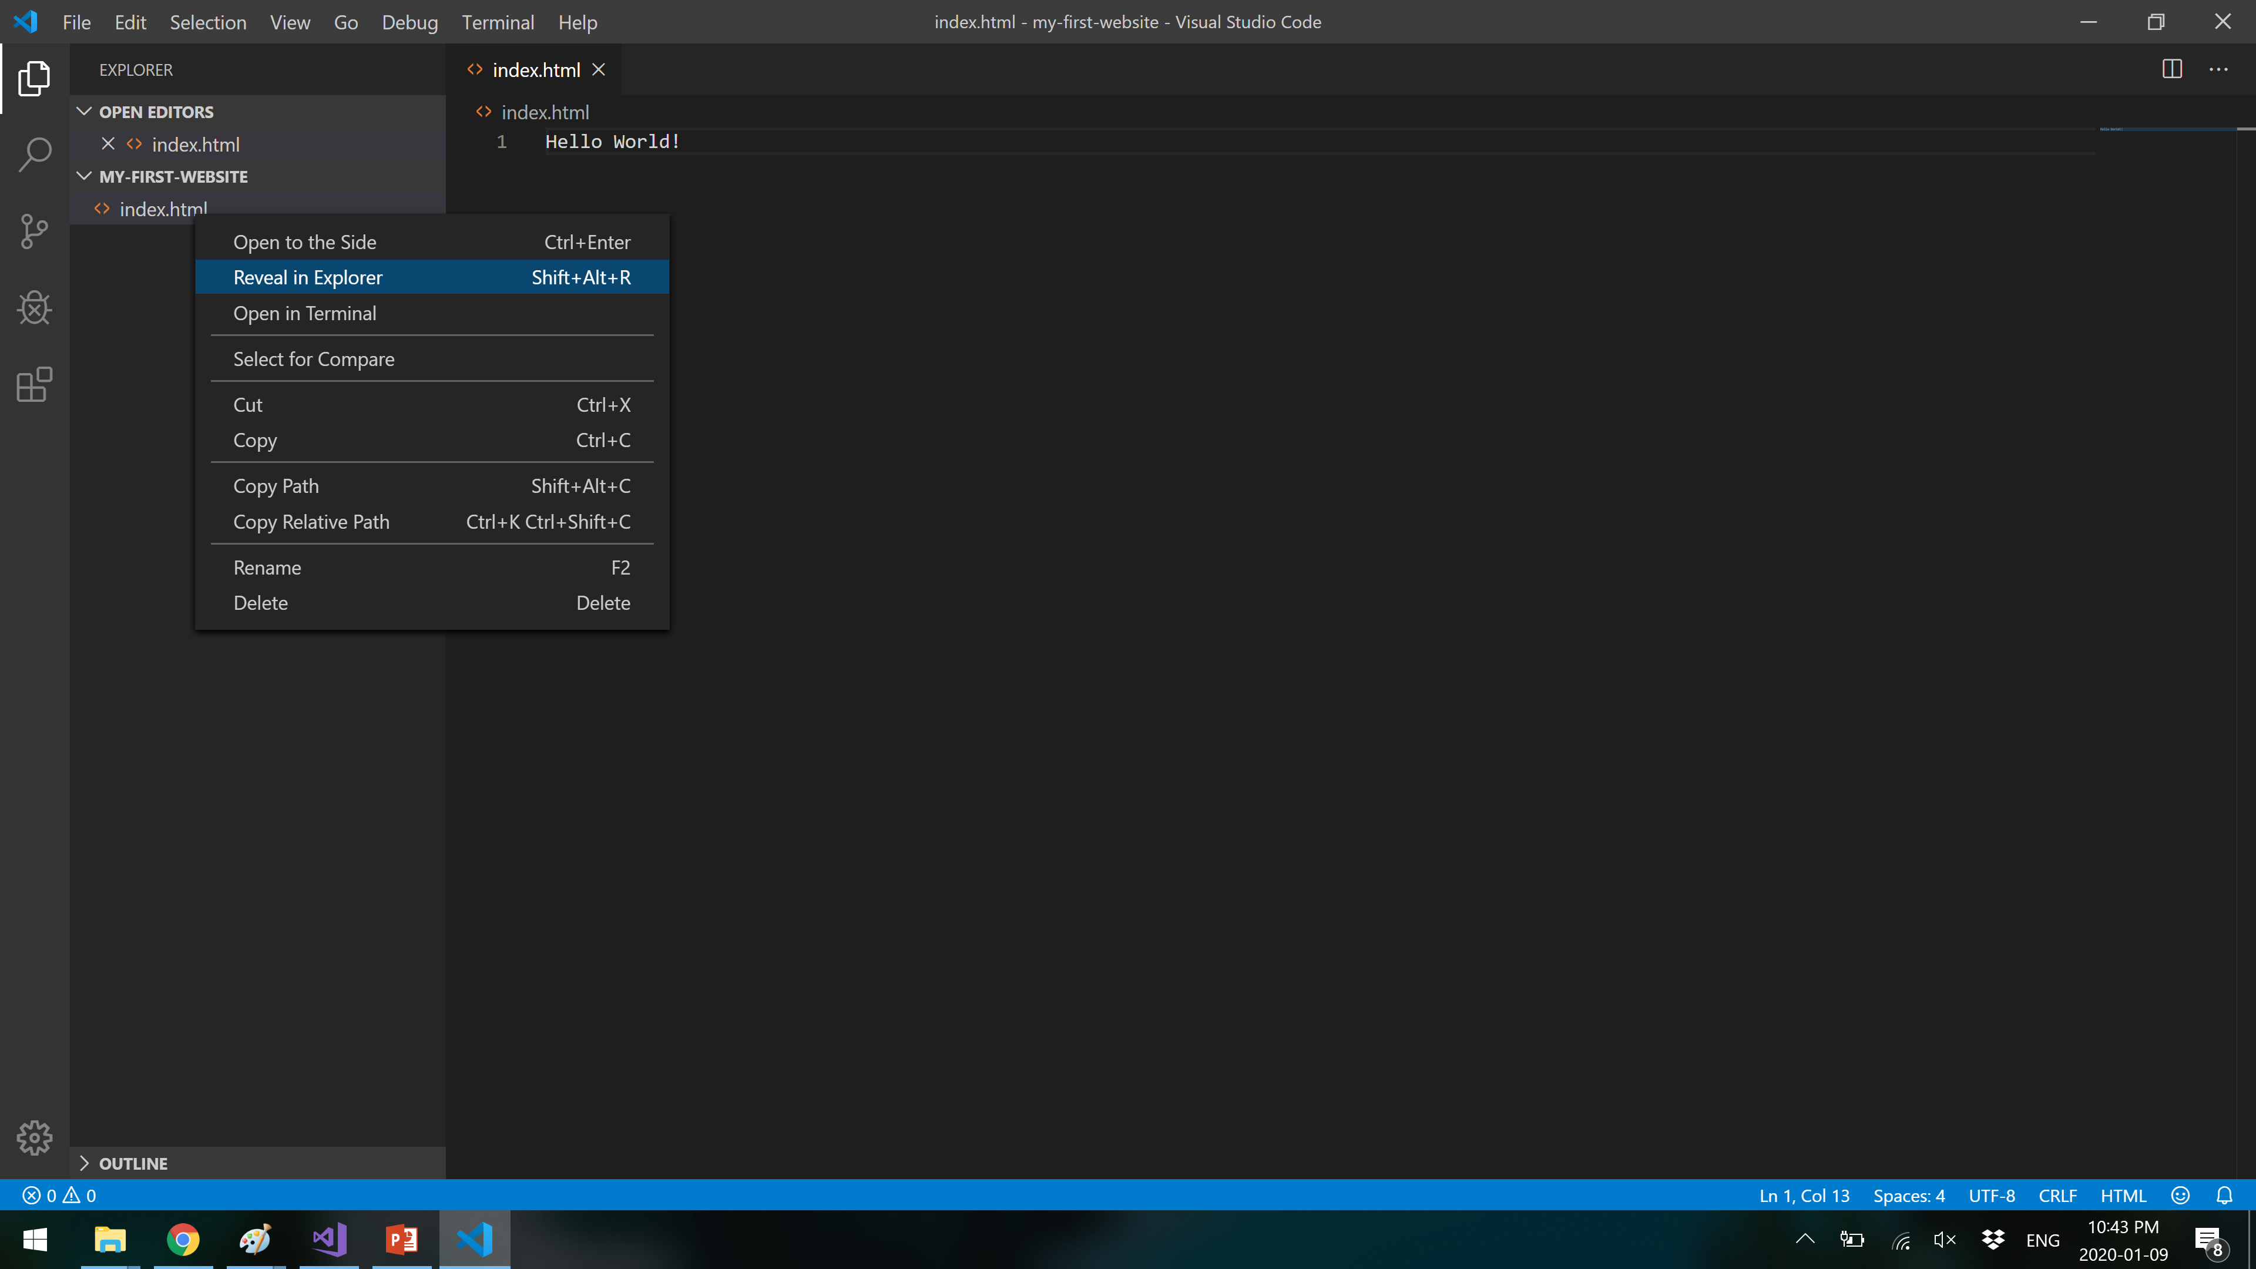
Creating A New Basic Website Part 9
Now that we have some content in our file, it’s time to open it.
Right click on the file in the Workspace panel, and click “Reveal in Explorer”.

Slide 17
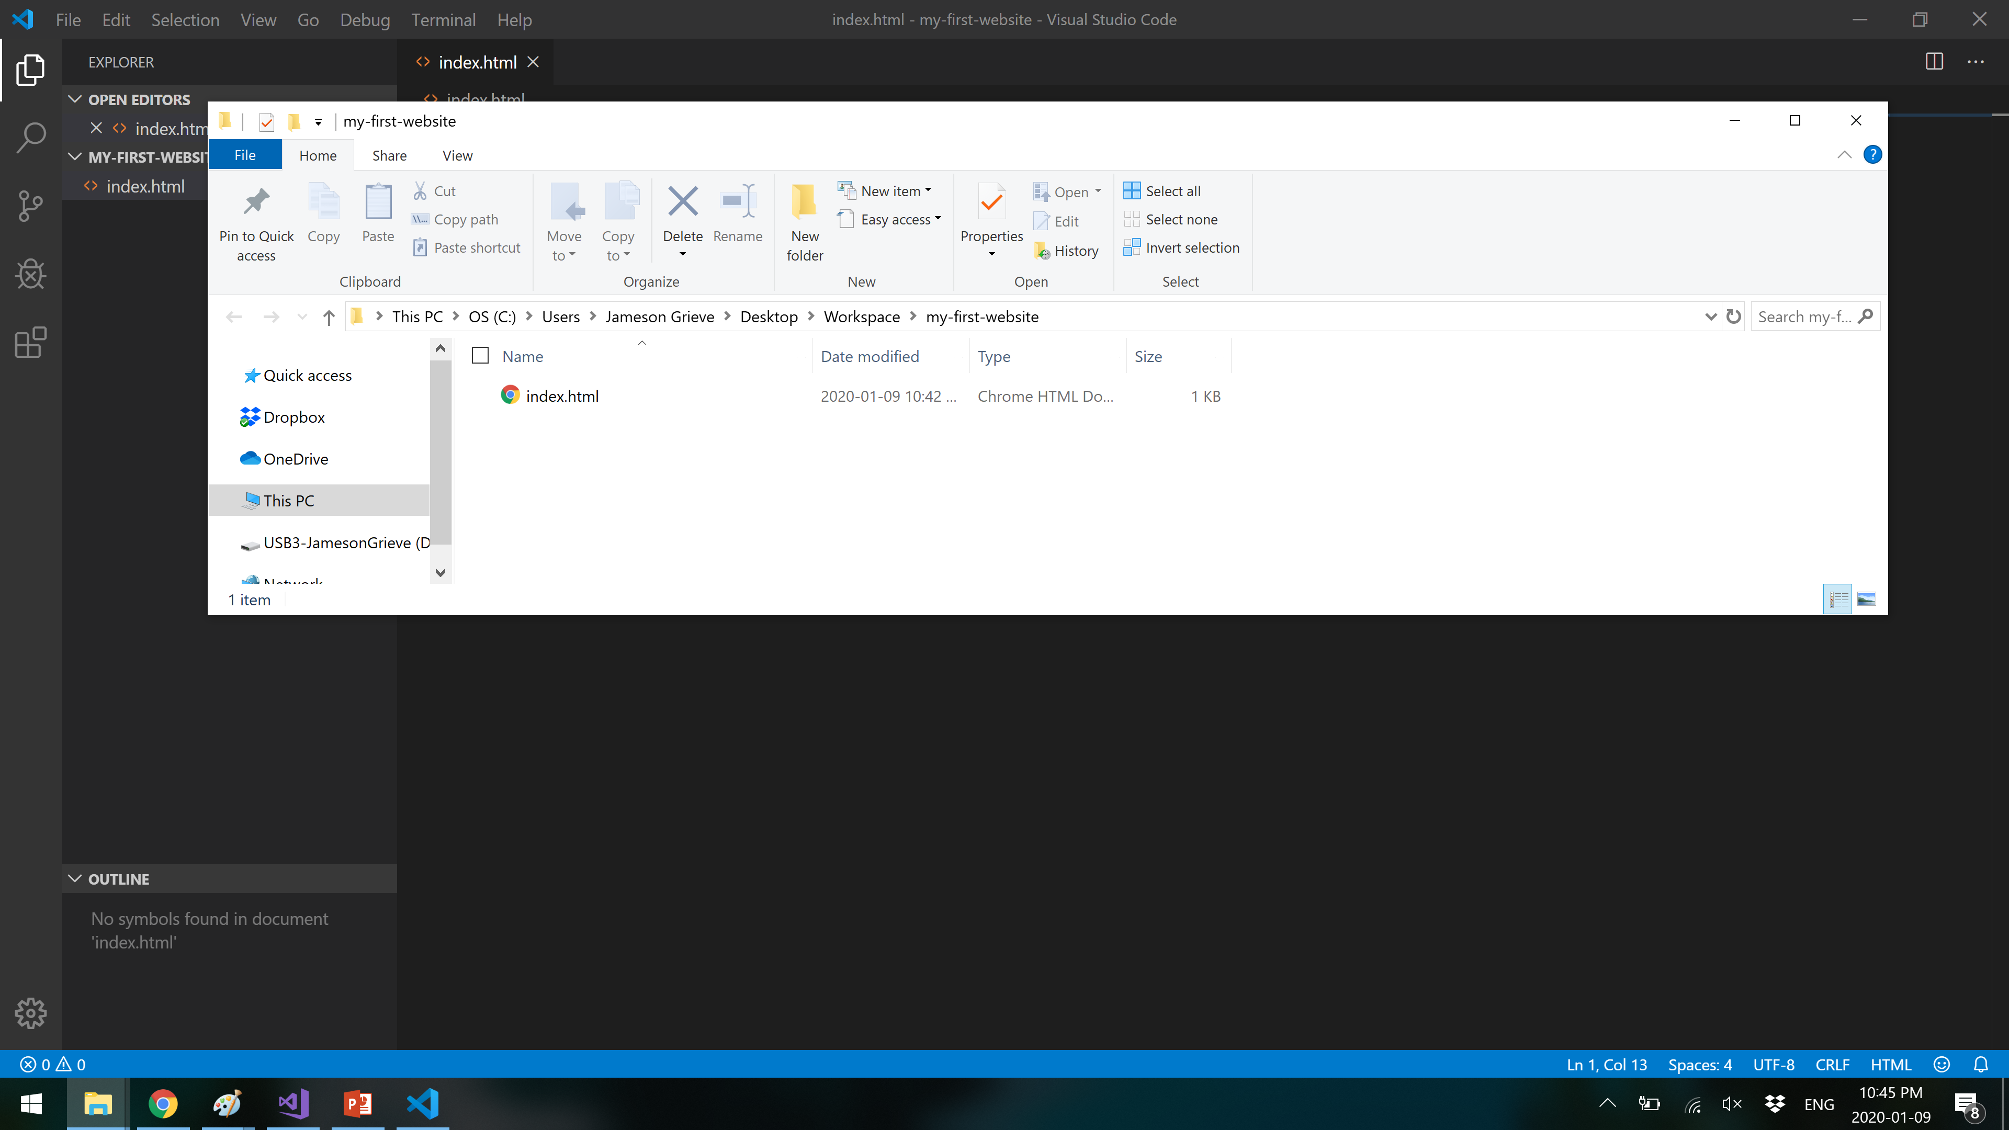
Creating A New Basic Website Part 10
This will open a Windows Explorer window in your website folder.
Double click on your HTML file and it will open in your default web browser.

Slide 18
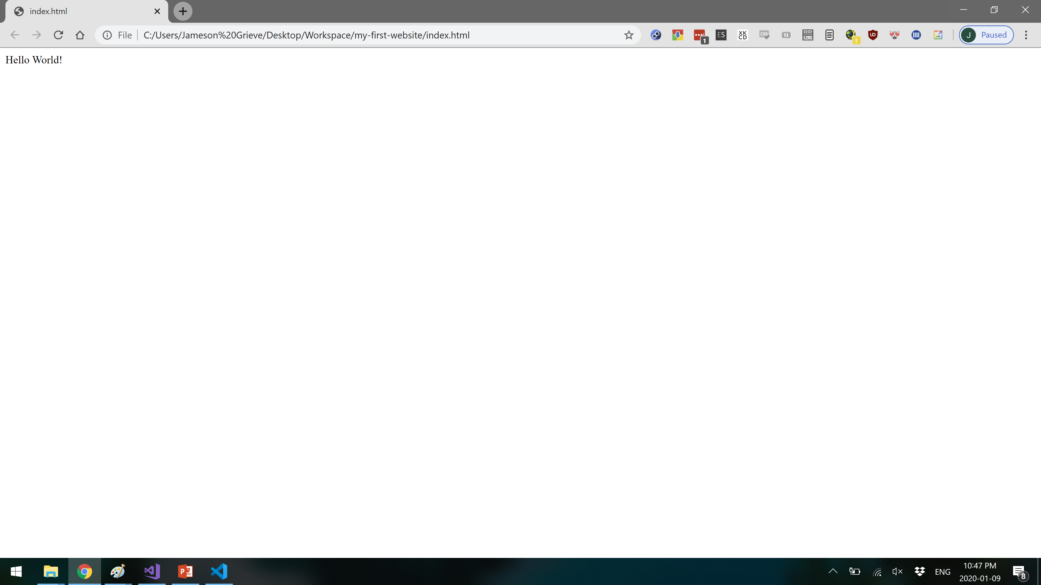
Creating A New Basic Website Part 11
Congratulations! You’ve just created and viewed a (very) basic website.
Let’s quickly take a look at how to make and view edits before moving on.
Keep this browser window open!

Slide 19
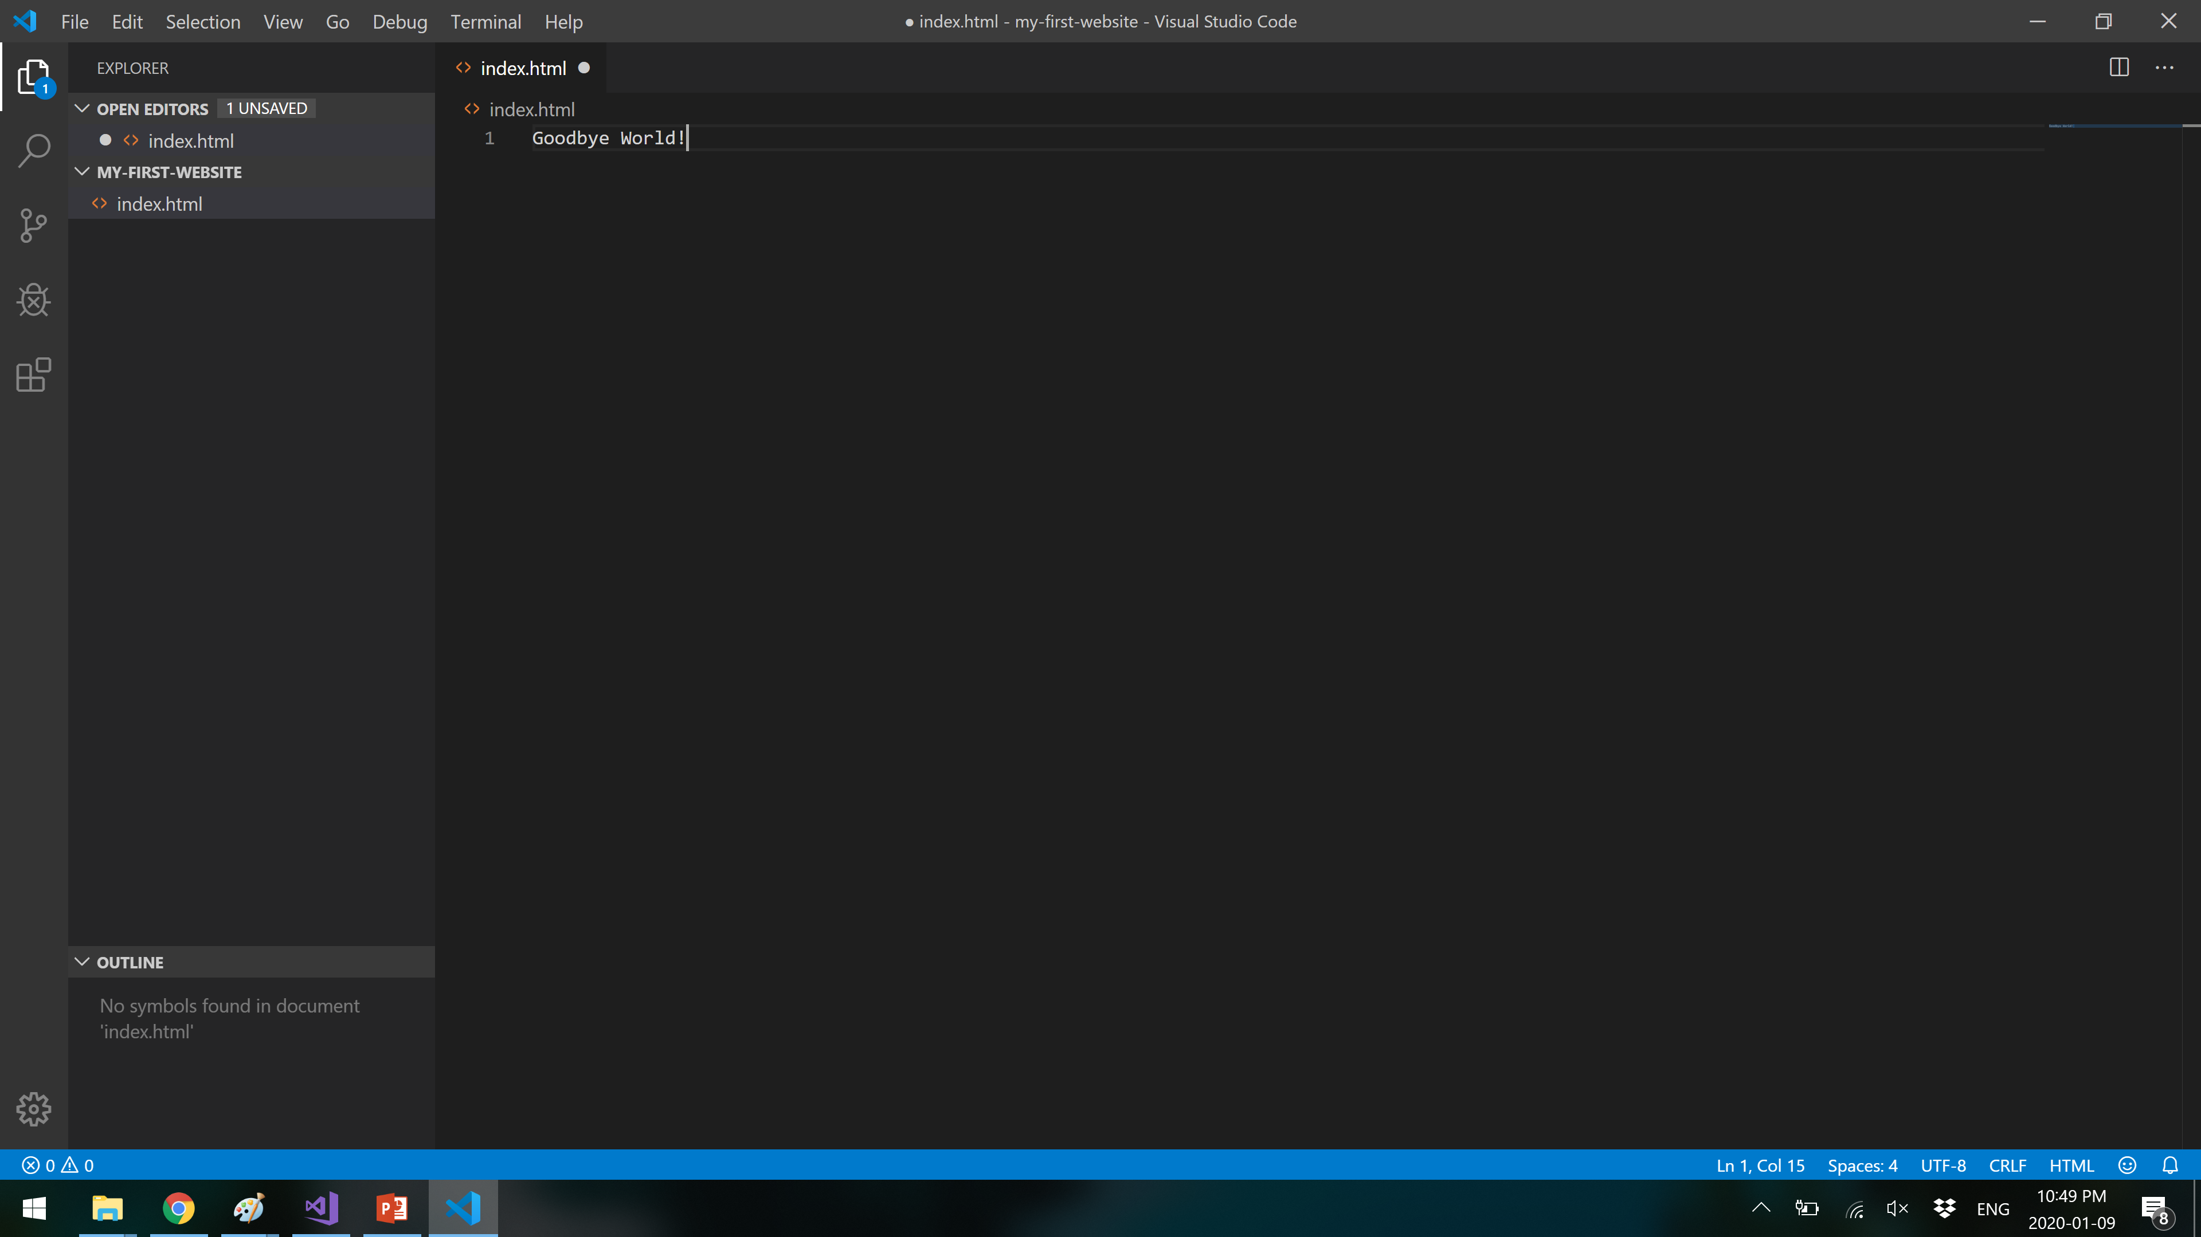
Updating a Website Part 1
Back in VS Code, let’s update the text in our HTML file.
Remember to save the file when you’re done.

Slide 20

Updating a Website Part 2
Back in your web browser of choice, hit the refresh button (upper left, beside the back/forward and home buttons), or hit the F5 key.
Your updates are now visible!

Slide 21
Updating a Website Part 3
Now I think we can all agree this is a bit of a threadbare website.
Before we move on though, let’s address some other things.

